Slide 1

Personal Finance Chatbot: Intelligent Guidance for Savings, Taxes, and Investments
Discover how AI-powered chatbots are revolutionising personal finance, making expert guidance accessible to everyone.

Slide 2
The Rise of AI in Personal Finance
Accelerated Adoption
24/7 Personalised Advice
Accessibility & Efficiency
Over 65% of financial service providers now use AI chatbots to enhance customer experience (2025 data).
Chatbots offer round-the-clock, tailored financial guidance, transforming how individuals manage their money.
From budgeting to investing, AI is democratising finance, making it more accessible and efficient for all.

Slide 3
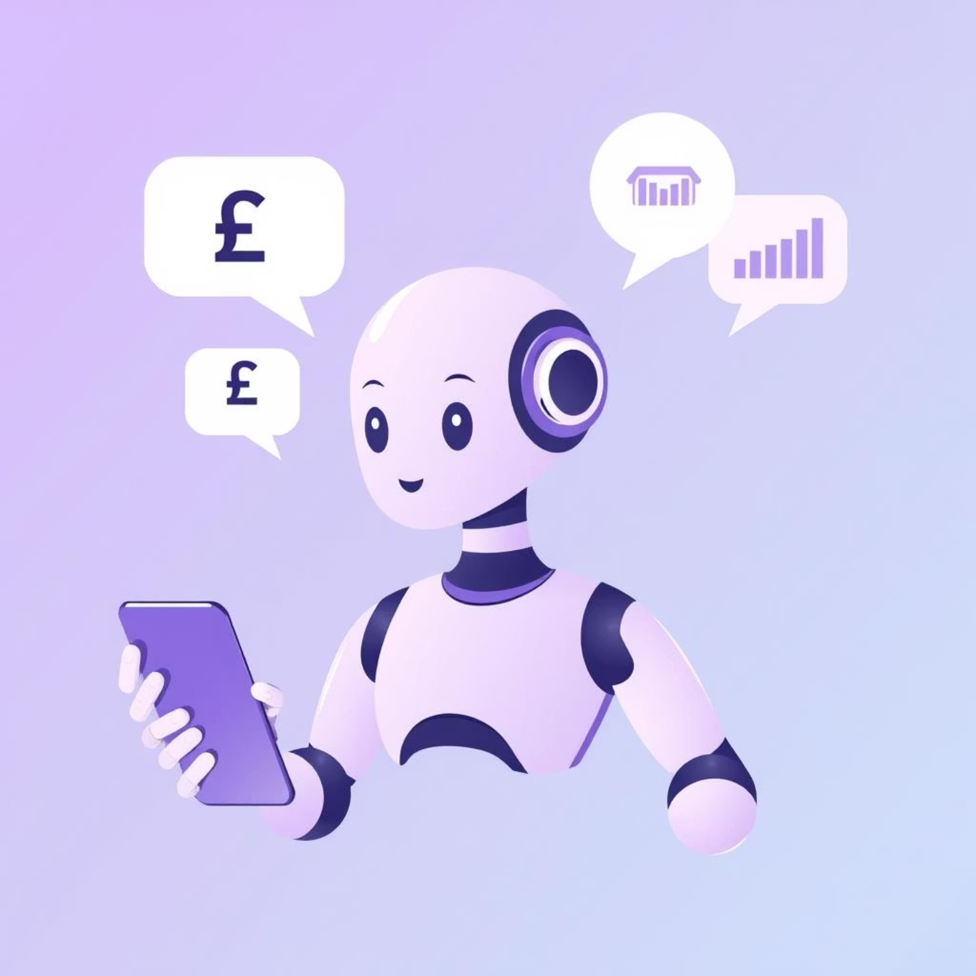
What Is a Personal Finance Chatbot?
AI-powered virtual assistant: Utilises Natural Language Processing (NLP) and Machine Learning (ML).
Natural language understanding: Comprehends queries like: “How much did I spend on groceries last month?”
Real-time data integration: Connects securely to bank APIs for live financial data and transactions.

Slide 4




Core Intelligent Features
Expense Tracking
Budgeting Insights
Automated tracking and categorisation (rent, dining, utilities) using AI classification.
Real-time updates, e.g., “You’ve spent 70% of your grocery budget this month.”
Savings Plans
Tax Optimisation
Tailored plans based on income, goals, and spending habits.
Personalised tax reminders and optimisation tips.

Slide 5

Investment Guidance Powered by AI
Risk-based recommendations: Analyses financial history and risk tolerance for investment options.
Diversified portfolios: Suggests mutual funds, savings accounts, or direct investments aligned with goals.
Timeline-based planning: Helps save for specific targets, such as a car in 3 years or retirement in 20 years.
Continuous learning: Adapts and refines advice through reinforcement learning for optimal results.

Slide 6




Real-World Success Stories
Cleo AI Assistant
Digit App
Prompt Engineering
Helped users identify small savings, like cancelling unused subscriptions, leading to potential £10,000+ in savings over decades.
Automated micro-savings, enabling users to save thousands effortlessly without conscious effort.
Custom-built chatbots deliver clear, actionable financial plans tailored precisely to individual user goals.

Slide 7




Security & Compliance: Trust Is Key
Data Encryption
Regulatory Adherence
Uses AES-256 encryption and OAuth 2.0 for secure data exchange with financial institutions.
Adheres to financial regulations such as KYC (Know Your Customer) and AML (Anti-Money Laundering) to ensure compliance and user safety.
User Authentication
Multi-factor authentication (MFA) and biometric options protect user accounts from unauthorised access.
Why is this important?
Robust security measures build user trust and ensure the integrity of personal financial data.

Slide 8
Benefits for Users and Financial Institutions
User Empowerment
Cost Reduction
Users gain personalised, accessible financial coaching anytime, anywhere, fostering financial literacy.
Institutions reduce customer service costs by up to 40% through automation, optimising resource allocation.
Operational Efficiency
Scalability
Improves efficiency and customer satisfaction with instant responses, eliminating wait times.
Scales effortlessly during high-demand periods without human bottlenecks, ensuring consistent service.

Slide 9

The Future of Personal Finance Chatbots
The evolution of personal finance chatbots promises even greater integration and sophistication:
Integration with voice assistants and metaverse platforms for immersive financial planning.
Advanced AI models to provide fiduciary-level advice with ethical guardrails.
Expansion into tax filing automation and real-time investment portfolio rebalancing.
Democratising financial literacy and empowerment globally, ensuring everyone benefits.

Slide 10


Take Control of Your Financial Future Today
"The future of personal finance is intelligent, personalised, and always at your fingertips."
Embrace AI-powered chatbots for smarter savings, tax management, and investments. Start with trusted apps or build your own tailored assistant using no-code platforms.

